Slide 1

LALBUS
University of Dhaka
Dept. of Computer Science and Engineering
CSE-4114
Web Lab Project

Slide 2
Group Members
Mehedi Hasan Masum
Roll: 02
Md. Fahim Arefin
Roll: 08
Instructor
Dr. Md. Mamun-or-Rashid
Professor, CSE, DU

Slide 3
Contents
The Idea
How we built it
Features
Future Improvements

Slide 4
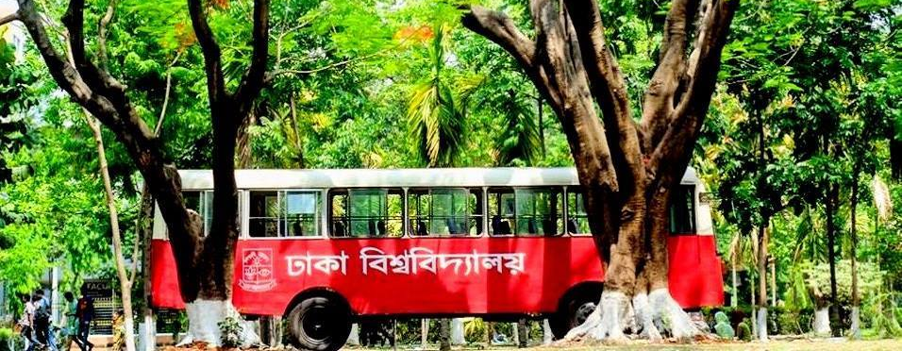
The Idea
The long awaited
“Where is my bus” web app

Slide 5
How we Built it
PHP
HTML5
CSS3.0
Javascript
Twitter Bootstrap

Slide 6
Features: Functionalities
Track Bus Location
Up votes, Down votes, Points
View Up-to-date Schedule
Search Bus by Stoppage
Follow Bus for Updates
Edit Bus Route, Schedule and Stoppage
Admin Panel for Verifying User Suggestions
Responsive design

Slide 7
Features: Internal
Built From Scratch
No frameworks
Model-View Control
User Access Control
SQL Injection Escaping

Slide 8
FUTURE Improvements
Actual Hardware based tracking
Template caching for saving user’s mobile data
Secured HTTPS server for User’s location accessing
Mobile Application

Slide 9
Thanks for your time!

